Slide 1
Analysis of Employee Retention rate
Internship in eSparsh Technologies Pvt Ltd(Bangalore)

Slide 2
Table of Contents
Introduction
Abstract
The dataset
Data Preprocessing
Training the Dataset
Choosing the Machine Learning Model
About the Machine Learning Model
Deploy the Model
Visualization
Conclusion

Slide 3
Abstract
Employee retention is a critical concern for organizations, and predicting retention rates can help proactively identify factors influencing attrition. In this project, we propose a machine learning-based approach to predict employee retention rates using historical employee data. Through data preprocessing, feature engineering, and training various machine learning models, we evaluate and optimize their performance. The selected model is deployed in a production environment for real-time predictions. This project aims to provide valuable insights into factors influencing retention, enabling organizations to implement targeted strategies for improving employee satisfaction and reducing attrition, ultimately leading to enhanced talent management and organizational performance.

Slide 4
Introduction
- Employee retention is a critical concern for organizations as high turnover rates can incur significant costs and disrupt business operations.
- To address this challenge, organizations are increasingly adopting data-driven approaches to gain insights into factors influencing employee retention.
- This project aims to develop a machine learning-based model for predicting employee retention rates using historical employee data.
- By analysing factors such as job satisfaction, age, promotion history, work-life balance, and employee demographics, organizations can understand the drivers of attrition and implement targeted strategies for improving retention.
- The project involves stages such as data collection from the HR database, data preprocessing to handle missing values and outliers, and feature engineering to extract meaningful insights.
- Machine learning algorithms including logistic regression, decision trees, random forests, and XGB Classifier are trained and evaluated to identify the best model for predicting retention rates.
enhance employee satisfaction, engagement, and overall talent management.
- By leveraging machine learning, organizations can gain a deeper understanding of retention factors, leading to improved organizational performance and a positive work environment.

Slide 5
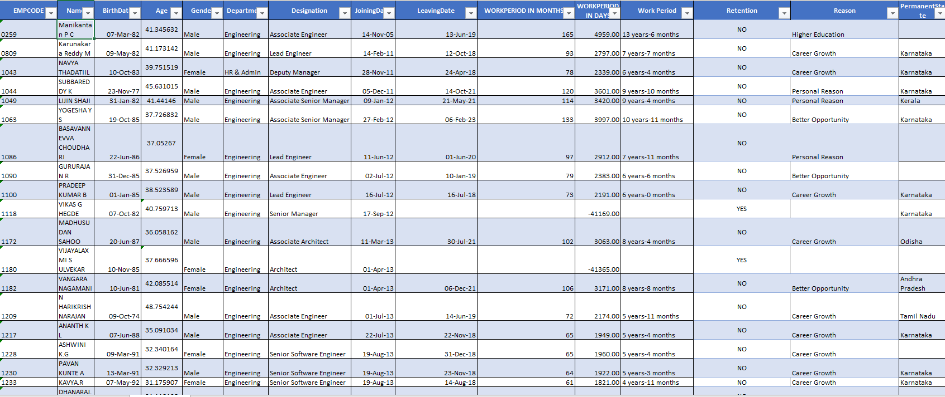
The Dataset

Slide 6
Attribute Description
Attribute | Description | Type
Age | Age of Employees | Numerical Discrete
Gender | Gender of the person | Categorical
Department | 1-Engineer,2-IT,3-Finance,…………… | Categorical
Designation | 1- Associate Engineer,2- Architect,3-Assistant manger,……………. | Categorical
Work period in Months | Numeric | Discrete
Joining Date | Date | dd//mm//yyyy
Leaving Date | Date | dd//mm//yyyy
Retention | 1- Yes, 0 - No | Categorical

Slide 7
Data Preprocessing
Removing the unwanted columns/fields in the dataset.
Checking for Null values.
Fill the Null values.
Data Type – Numerical – Use Mean / Median
Data Type – Text – Mode
Change the categorical values to numerical.
Label encoder
Word to vector

Slide 8
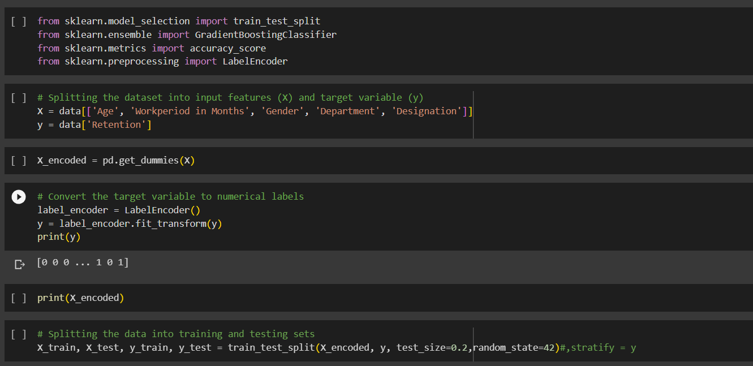
Training and testing the Data into Model

Slide 9
Choose the Machine Learning Model
For the above features and the target variable we can use the following model,
GradientBoostingClassifier – 0.794
LogisticRegression – 0.686
XGBClassifier – 0.8
Hence here we have high accuracy in XGB Classifier.

Slide 10
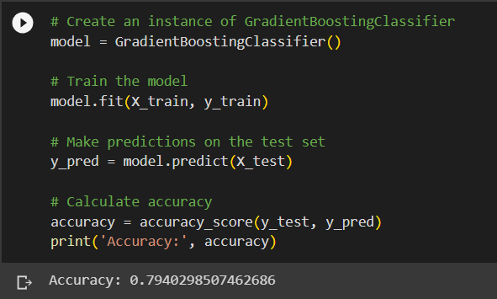
GradientBoostingClassifier

Slide 11
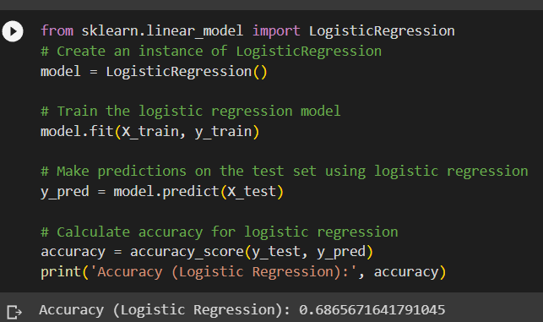
LogisticRegression

Slide 12
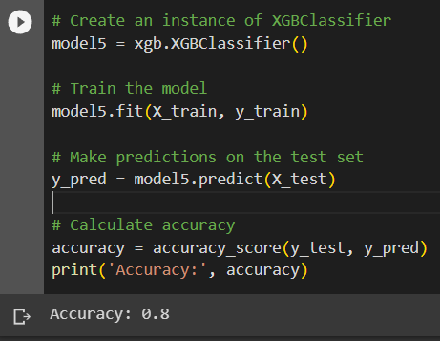
XGB Classifier

Slide 13
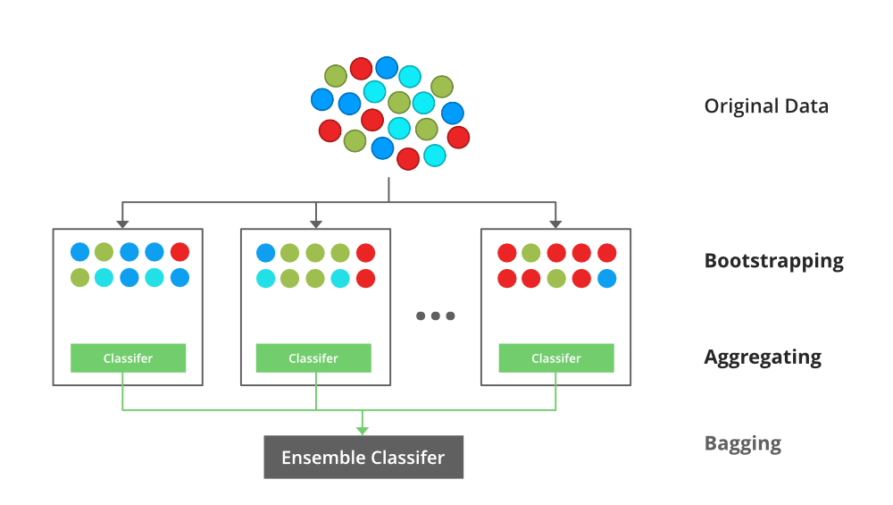
About the M.L Model(XGB Classifier)
XGBClassifier uses an ensemble of weak prediction models called decision trees. It builds trees sequentially, where each subsequent tree tries to correct the mistakes made by the previous trees. This process is known as gradient boosting.
XGBClassifier optimizes an objective function that quantifies the model's performance. The objective function measures the difference between the predicted and actual values and guides the algorithm to minimize this difference.

Slide 14
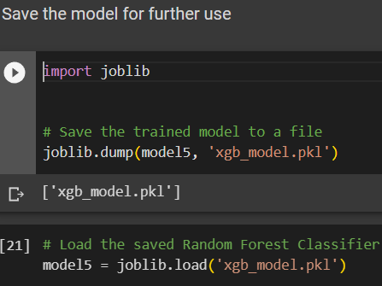
Deploy the Model
To deploy the model first we need to load the model as a file(.jkl) for which we are using the joblib library function.
After saving the model we need to get the user input.
Then deploy the model with the user input data.

Slide 15
Deploying the Machine Learning Model
Where the user input is collected in the getvalue_.

Slide 16
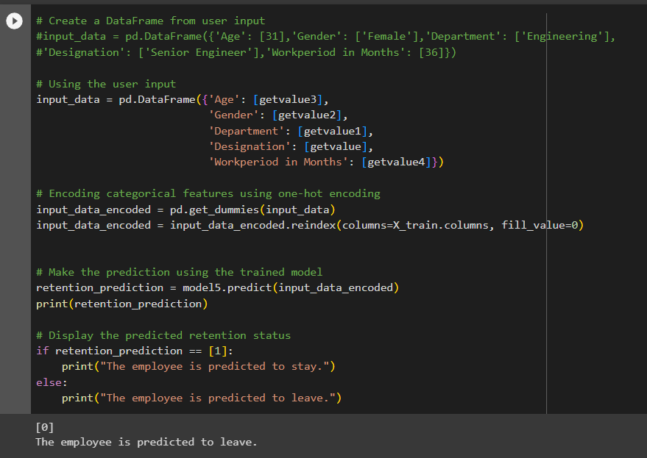

Slide 17
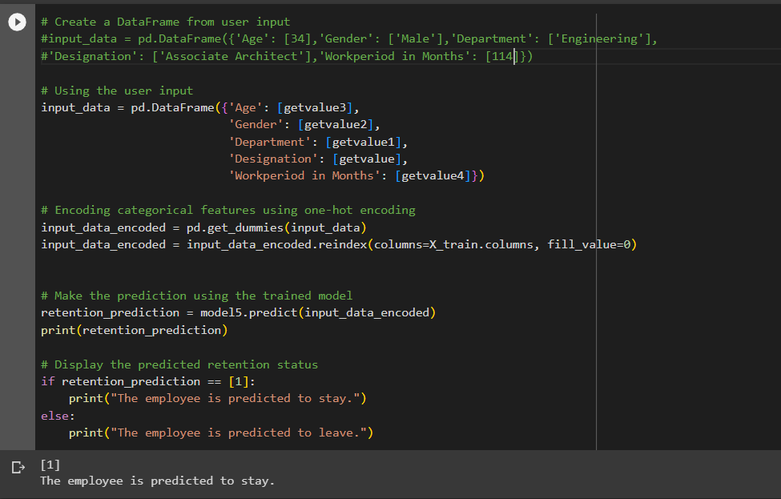

Slide 18
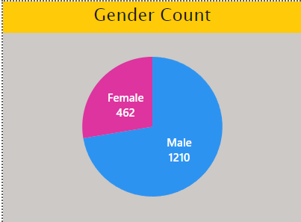
Visualization
Data visualization is the most important step in the data analysis and prediction process, because the visuals would be easily captured by our brain then the text.
We have used the Power BI software to visual the dataset.
And this report is linked with the Power BI visual so we could directly have the interaction.

Slide 19
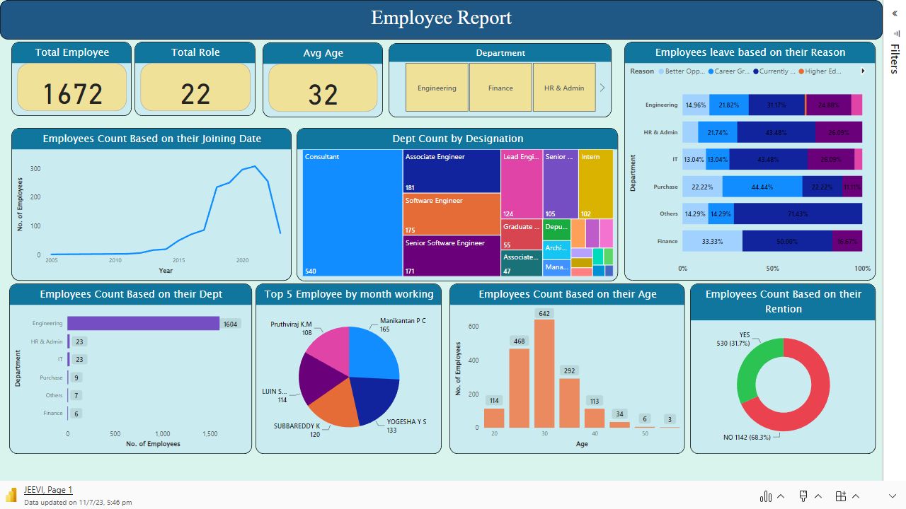

Slide 20
Data
ETL
Data Preprocessing
Feature selection
Explore ML Model
Assign Null Values
Label Encoder
Encode the Categorical Features
Logistic Regression
XGB Classifier
Gradient decent Boosting
Proposed
Work - Pipeline
Deploy the Model
Test the Model
Evaluate the Model
Build a Model
Check for the Minimum Evaluation
Accuracy
Precision
F1 Score

Slide 21
Conclusion
Thus a complete end to end ML pipeline was explored for predicting the employee retention rate.
The dataset is a good representative of the general workforce in today’s organizations. The good
results from multiple classifiers justify that the features chosen are causes that contribute to voluntary attrition.
The XGBoost classifier performed well than other ML algorithms with a validation accuracy of 80%
The reason for attrition of employees can’t be exactly predicted, because each person would have different ideas for their future goals.
Future work might include more number of attributes pertaining to the employee and a Sentiment Analysis can be made by collecting data from employees.

Slide 22
Thank You
S.Jeevith Kumar

